Slide 1



SchedInspector: A Batch Job Scheduling Inspector Using Reinforcement Learning
Di Zhang¹, Dong Dai¹, Bing Xie²
¹University of North Carolina at Charlotte
²Oak Ridge National Laboratory

Slide 2
Outline
Motivation & Background
SchedInspector Design
Evaluation & Analysis
Conclusion

Slide 3
Outline
Motivation & Background
SchedInspector Design
Evaluation & Analysis
Conclusion
Introduction of HPC batch job schedulers
Challenges of existing schedulers
Background of Reinforcement Learning

Slide 4
HPC Batch Job Scheduler
Job Queue (Waiting Jobs)
Job₁
Job₂
Job₃
…,…
Computing Nodes
s₁
s₂
s₃
HPC Batch Job Scheduler
n₁
n₂
n₃
Job_{i}
r₁
r₂
r₃
…
…
…
s: job submission time
n: the number of processors that a job requests
r: job’s runtime estimation (or upper bound) from users

Slide 5
HPC Batch Job Scheduler
Smallest Job First(Small)
Job Queue (Waiting Jobs)
Job₁
Job₂
Job₃
…,…
Computing Nodes
s₁
s₂
s₃
HPC Batch Job Scheduler
n₁
n₂
n₃
Job_{i}
r₁
r₂
r₃
…
…
…
s: job submission time
Enough Nodes?
n: the number of processors that a job requests
r: job’s runtime estimation (or upper bound) from users

Slide 6
HPC Batch Job Scheduler
Smallest Job First(Small)
Job Queue (Waiting Jobs)
Job₁
Job₂
Job₃
…,…
Computing Nodes
s₁
s₂
s₃
HPC Batch Job Scheduler
n₁
n₂
n₃
Job_{i}
r₁
r₂
r₃
…
…
…
s: job submission time
Yes, nodes are enough for the current job.
n: the number of processors that a job requests
r: job’s runtime estimation (or upper bound) from users

Slide 7
HPC Batch Job Scheduler
Smallest Job First(Small)
Job Queue (Waiting Jobs)
Job₁
Job₂
Job₃
…,…
Computing Nodes
s₁
s₂
s₃
HPC Batch Job Scheduler
n₁
n₂
n₃
Job_{i}
r₁
r₂
r₃
…
…
…
s: job submission time
No, nodes are not enough.
n: the number of processors that a job requests
Then, wait until nodes are released.
r: job’s runtime estimation (or upper bound) from users

Slide 8
HPC Batch Job Scheduler
Smallest Job First(Small)
Job Queue (Waiting Jobs)
Job₁
Job₂
Job₃
…,…
Computing Nodes
s₁
s₂
s₃
HPC Batch Job Scheduler
n₁
n₂
n₃
Job_{i}
r₁
r₂
r₃
…
…
…
s: job submission time
Now, nodes are enough for the current job.
n: the number of processors that a job requests
r: job’s runtime estimation (or upper bound) from users

Slide 9
Motivation Example
Smallest Job First(Small)
Job Queue (Waiting Jobs)
Job₁
Job₂
Job₃
Job₄
Computing Nodes
s₁
s₂
s₃
HPC Batch Job Scheduler
s₄
Request 12 nodes
30
20
12
10
Job₃
r₁
r₂
r₃
r₄
…
…
…
…
Job₄
s: job submission time
Delay
Job₃
Re-decide
Job₄
Hold
Until Enough Nodes for Job₃
10 nodes are available
n: the number of processors that a job requests
r: job’s runtime estimation (or upper bound) from users

Slide 10

Motivation
Job Queue (Waiting Jobs)
Job₁
Job₂
Job₃
…,…
Computing Nodes
Inspector
s₁
s₂
s₃
HPC Batch Job Scheduler
n₁
n₂
n₃
Job_{i}
r₁
r₂
r₃
…
…
…
s: job submission time
n: the number of processors that a job requests
Delay
r: job’s runtime estimation (or upper bound) from users
Accept

Slide 11
Without Inspector
Shortest Job First(SJF)
Completion Time :
10
Nodes
Job Queue (Waiting Jobs)
J₀
J₁
J₀
J₂
J₁
J₂
J_{p}
Selected to run
Selected to run
Selected to run
Time
t₀
t₁
t₅
t₁₀

Slide 12
With Inspector
Shortest Job First(SJF)
Completion Time :
9
Nodes
Job Queue (Waiting Jobs)
J₂
J₁
J₀
J₂
J₀
J_{p}
Accept
J₁
Selected to run
Selected to run
Selected to run
Delay
Accept
Time
t₉
Accept
t₀
t₁
t₄
Selected to run

Slide 13
Challenges
Current Status
Future Job Arrival
Understanding of historical data
Impact of the rejection
Whether the job is runnable
Attributes of the selected job
Number of rejected times
…

Slide 14
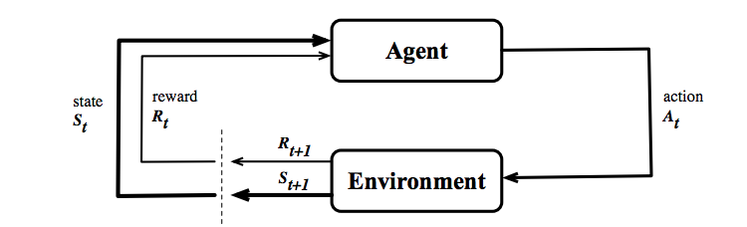
Reinforcement Learning
David Silver, et. al. Mastering the game of Go with deep neural networks and tree search, Nature vol. 529 (2016)
Volodymyr Mnih, et. al. Playing Atari with Deep Reinforcement Learning arXiv:1312.5602 (cs)
From https://www.selfdrivingcars360.com/how-autonomous-vehicles-fit-into-our-ai-enabled-future/

Slide 15
Outline
Motivation & Background
SchedInspector Design
Evaluation & Analysis
Conclusion
Overview of SchedInspector
Design of State and Reward

Slide 16
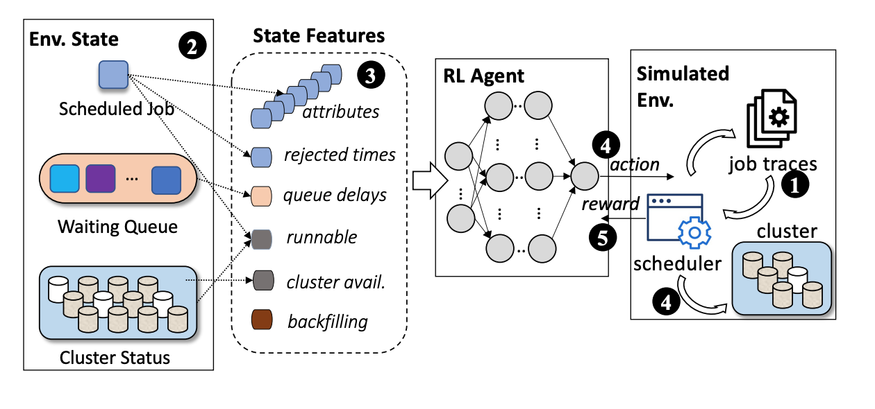
Our Contribution
The first scheduling inspector for HPC systems.
New optimizations of the state and reward to enable efficient RL training.
Extensively evaluations on efficiency, stability and interpretability of SchedInspector.

Slide 17
SchedInspector
Job Queue (Waiting Jobs)
Job₁
Job₂
Job₃
…,…
RL-based
Inspector
Computing Nodes
s₁
s₂
s₃
HPC Batch Job Scheduler
Job_{i}
n₁
n₂
n₃
r₁
r₂
r₃
…
…
…
Reward
s: job submission time
n: the number of processors that a job requests
r: job’s runtime estimation (or upper bound) from users

Slide 18
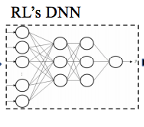
Design of State
Jc: Scheduled Job
RT: Rejected Times
CA: Cluster Avail.
Run: Runnable
Naïve Features
Compacted Features
State
Run
…
State
J3
CA
J2
RT
J1
Jc

Slide 19
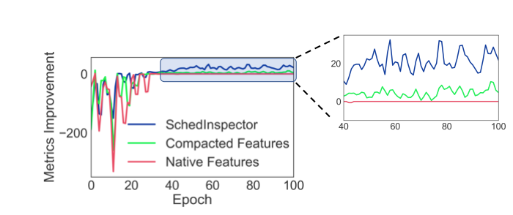
Design of State
SchedInspector
QD: Queue Delay
BF: Backfilling
BF
QD
State
Run
CA
RT
Jc

Slide 20
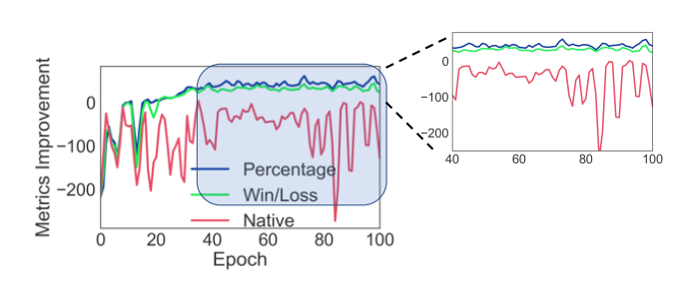
Design of Reward
Naïve:
Metric_{inspect} - Metric_{orig}
Win/Loss:
Integer(Metric_{inspect} > Metric_{orig})
Percentage:
(Metric_{inspect} - Metric_{orig})/ Metric_{orig}

Slide 21
Outline
Motivation & Background
RLScheduler Design
Evaluation & Analysis
Conclusion
Usability
Efficiency
Interpretability

Slide 22
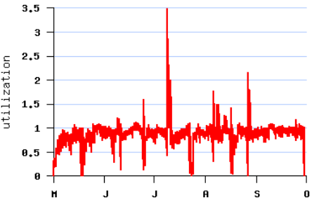
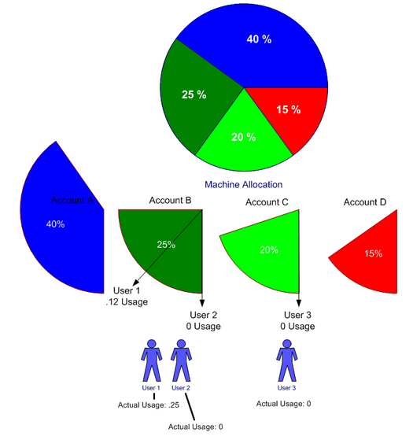
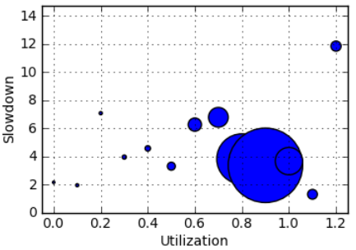
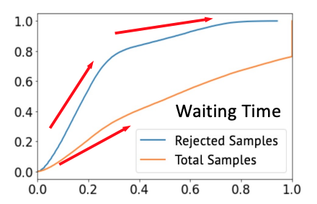
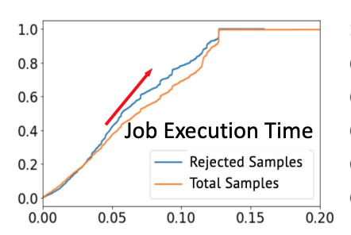
How is the performance on various job traces?
How is the performance for different scheduling policies?
How is the performance of different metrics?
Usability
Evaluation
Outline
How fast and stable can SchedInspector converge?
What pattern it is in the training of SchedInspector?
Efficiency
What does Schedinspector learn and what we can learn from it?
Interpretability

Slide 23
Usability
Evaluation
Outline
Efficiency
Interpretability

Slide 24
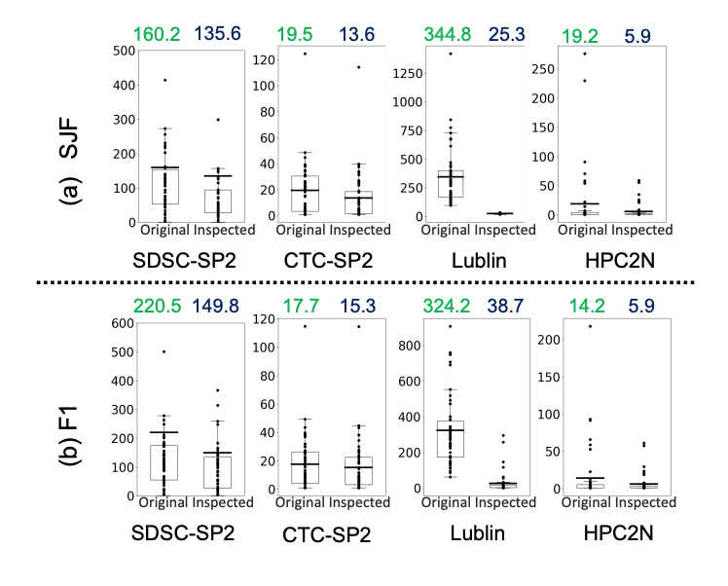
Testing for Different Job Traces and Policies
SchedInspector has significant improvement for the two scheduling policies on all job traces.

Slide 25
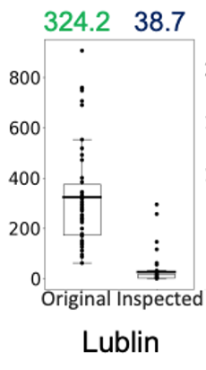
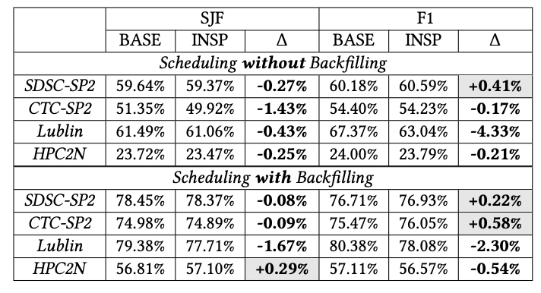
Impact on System Utilization
88% Improvement
SchedInspector has barely noticeable reduction (1% difference) on system utilization

Slide 26
Usability
Evaluation
Outline
Efficiency
Interpretability

Slide 27
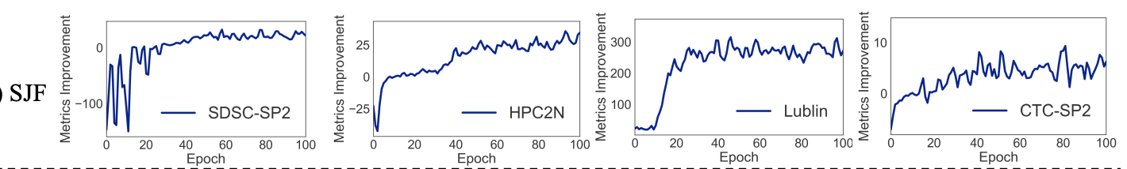
Training on Different Job Traces
SchedInspector converges in all of the workloads within 100 training epochs and different job traces have different converge pattern.

Slide 28
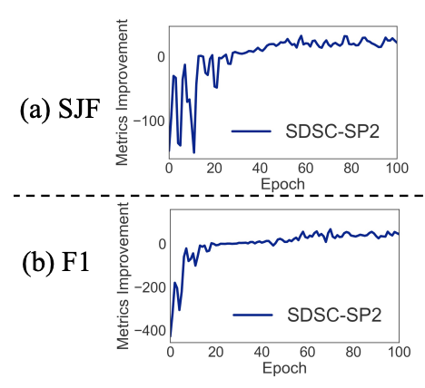
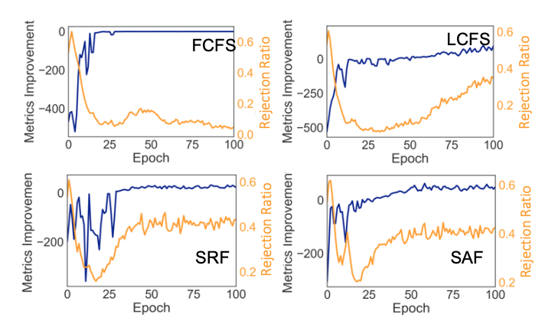
Training on Different Scheduling Policies
SchedInspector converges in all scheduling policies.
For some scheduling policies, the converged value is near 0 and the rejection ratio is low.

Slide 29
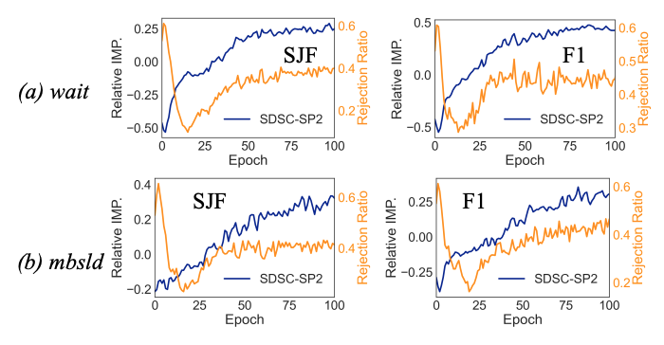
Training for Different Metrics
SchedInspector converges towards two new metrics but with different patterns.

Slide 30
Usability
Evaluation
Outline
Efficiency
Interpretability

Slide 31
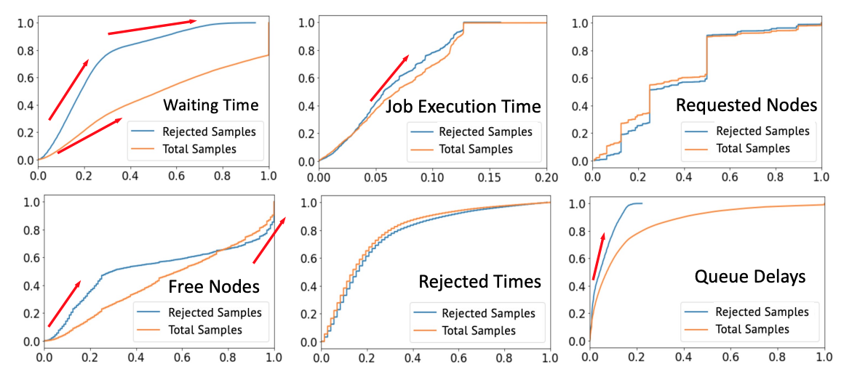
What SchedInspector Learns
CDF of input features.
SchedInspector has obvious patterns for different features which indicates the effectiveness of feature selection

Slide 32
Outline
Motivation & Background
SchedInspector Design
Evaluation & Analysis
Conclusion

Slide 33
Summary
We introduces scheduling inspector to integrate runtime factor into existing batch job scheduling.
https://github.com/DIR-LAB/SchedInspector
We conducted extensive evaluations to show how SchedInspector performs on various job scheduling policies under various workloads.
We carefully analyze and summarize the statistical rules learned by SchedInspector.

Slide 34

Thank you! & Questions?

